Slide 1

Vehicle crashes in Texas
Data for 2013

Slide 2
Agenda
A look at fatalities
By city
By speed limit
By day of the week
Number of crashes and injuries
By day of week
By crash severity
By speed limit
By surface condition
By road type
Total injury count by highway system

Slide 3
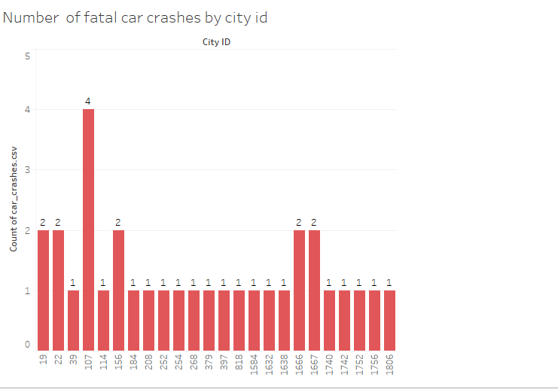
Fatal accidents by city
The city represented by id number 107 saw the most fatal accidents, with four (of the information we have.)
The remaining cities in which a fatal accident occurred saw either one or two such accidents
This chart does not take into account population size. It would be interesting to see whether city 107 is the most heavily populated

Slide 4
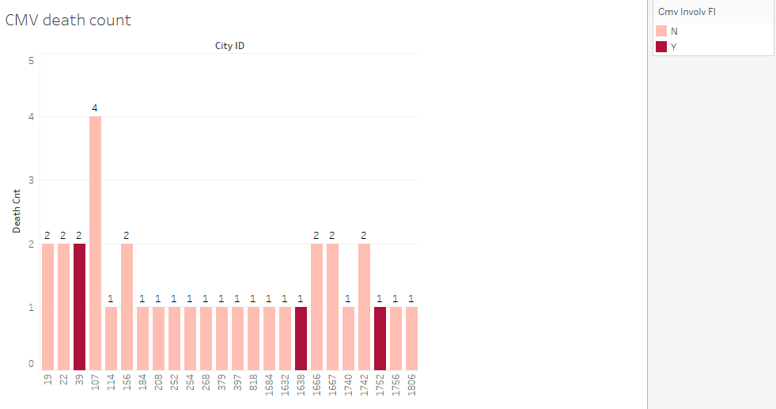
Number of fatalities by city id, whether CMV involved
A look at the total number of deaths (vs. the number of fatal accidents on previous slide.)
There were a total of 34 deaths.
Mostly, these numbers match the number of fatal accidents.
However, cities 39 and 1742 had one more fatality than number of fatal accidents, meaning an accident had more than one fatality.
The fatal accident in city 39, which saw two deaths, involved a commercial motor vehicle, as did the fatalities in cities

Slide 5
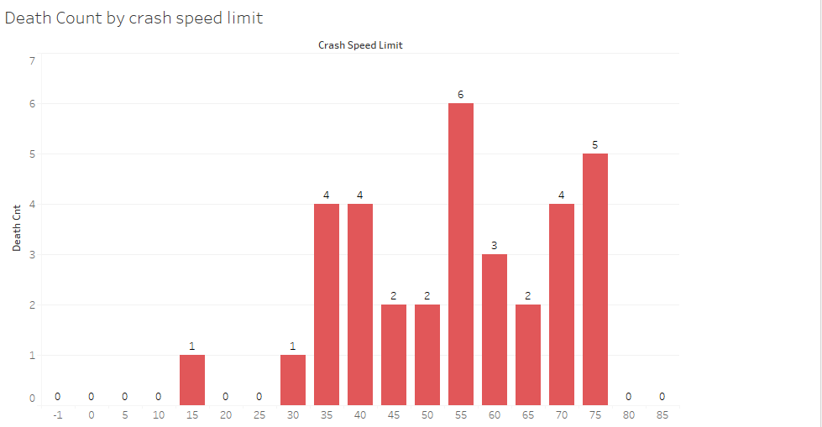
Number of deaths by speed limit
Most deaths occurred in areas where the speed limit was 55.
The next highest was at 75 mph, which isn’t surprising.
It’s interesting that more deaths occurred in areas where the speed limit was 35-40 than in some areas where the speed limit was higher. However, this chart shows the speed limit, not the actual speed the drivers were driving. Plus, there were far more accidents at the lower speeds.

Slide 6
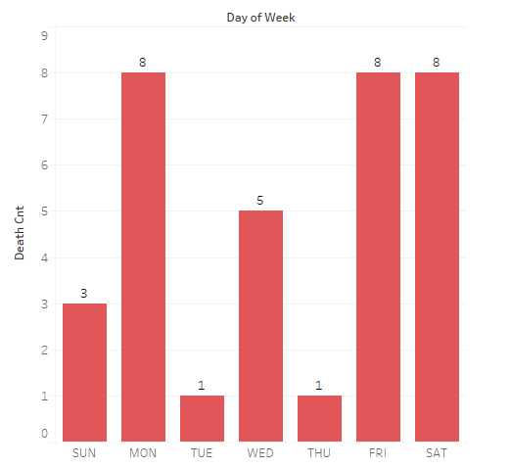
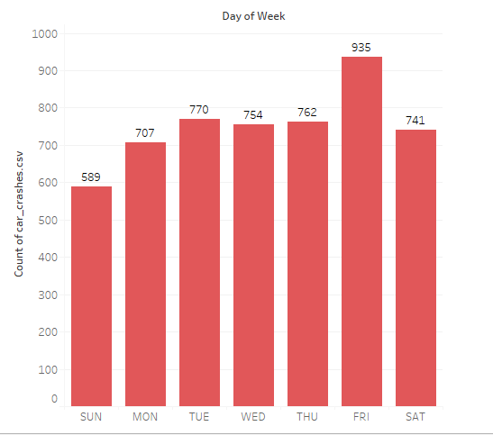
Death count and crash count by day of week
Friday saw the most crashes and is tied with Monday and Saturday in number of deaths. It would be interesting to explore factors that might have contributed to the higher number of deaths on these days. Is it weekend revelry and crankiness on Mondays that lead to worse accidents?

Slide 7
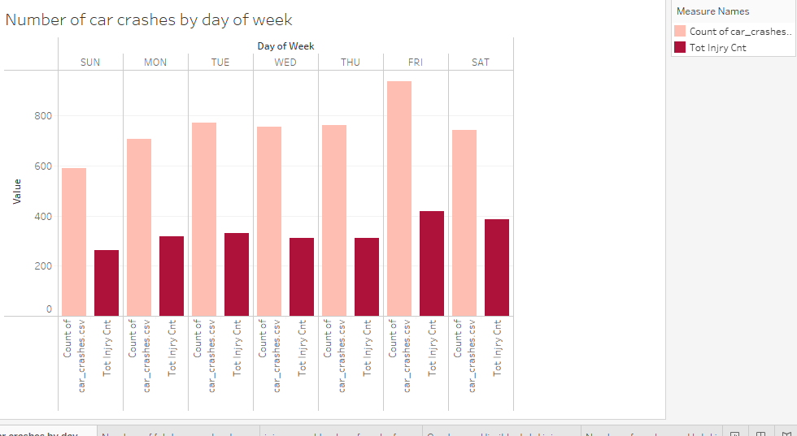
Number of crashes and injuries by day of week
A comparison of total crashes with total number of injuries for each day of the week.
The average total injury count per accident was 0.445.
Fridays and Saturdays saw the most injuries, as they did fatalities (as we saw on the previous slide.)
It appears Saturdays had a bigger percentage of crashes resulting in injuries than Fridays

Slide 8
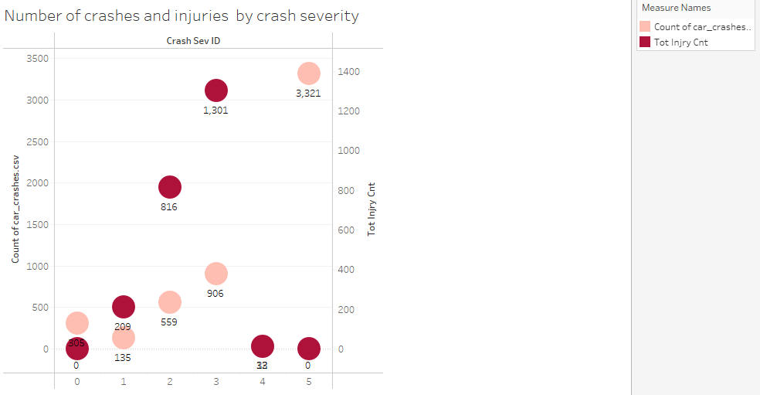
Crashes and injuries by crash severity
We don’t know what the crash severity id numbers mean, but we can guess from the data. (BUT they are guesses!)
Most accidents were a severity 5, while there were no injuries at that level, indicating severity id 5 might be the least severe.
At severity ids 1-3, there were more injuries than number of accidents, indicating that in at least some of the accidents more than one person was injured. I’m not sure whether zero is an actual id or if zero was inserted when the information wasn’t available.

Slide 9
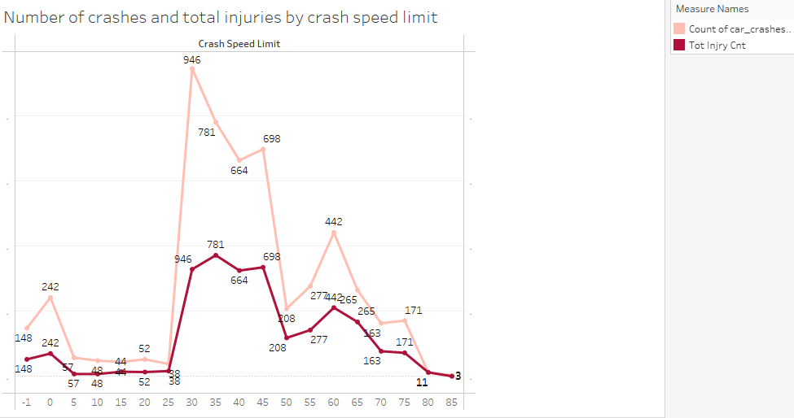
Crashes and injuries by speed limit
The speed limit that saw the most crashes was 30. It’s important to note this graph looks at raw numbers, not percentages. We don’t know the breakdown of speed limits (there could be many more areas with a speed limit of 30 than others.
The highest raw number of injuries occurred in areas where the speed limit was 35. This is interesting. However, we see that the space between the two lines narrows significantly at around 50 mph, and the lines meet at 80 mph, showing that as speed limit increases, a bigger portion of crashes result in injury.
Average total injury count per accident: 0.445.

Slide 10
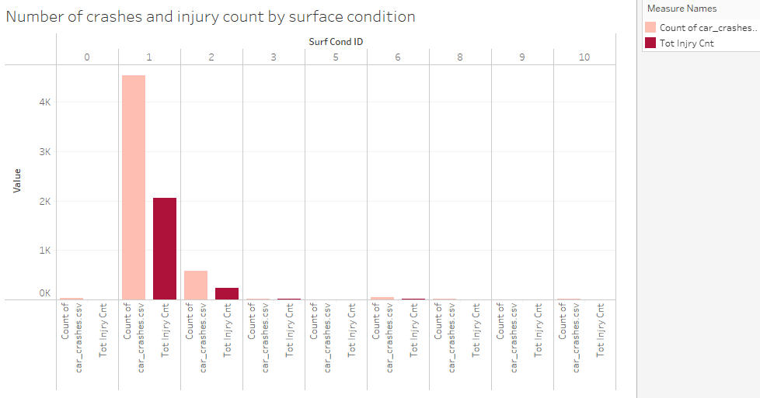
Number of crashes and injuries by surface condition
We don’t know what each surface condition Id stands for, but it’s interesting to note that whatever condition 1 stands for, that surface condition was present in a big chunk of accidents and injuries.
.

Slide 11
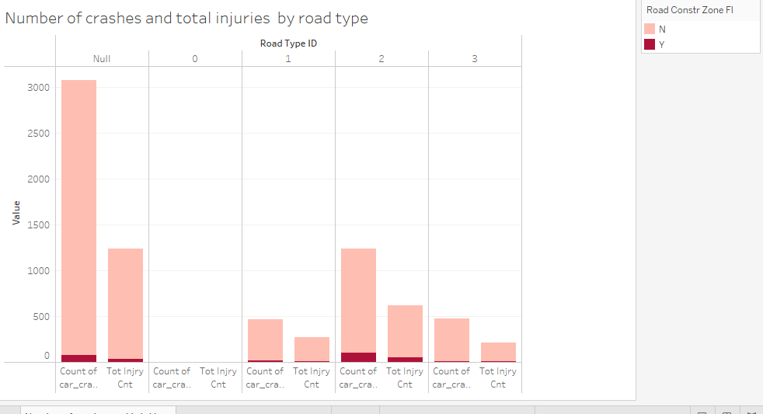
Crashes by road type, whether construction zone
A lot of this data are missing, but we can see that of the data we have, it looks as if the highest number of accidents and injuries occurred on road type 2.

Slide 12
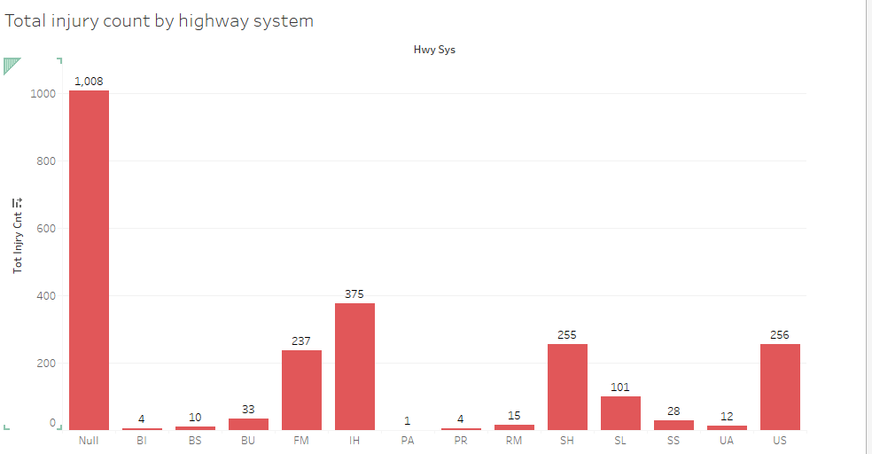
Total injury by highway system
A lot of this data are missing as well, but we can see that of the data we have, it looks as if the highest number of accidents occur on IH (interstate highway?) systems.

Slide 13
Takeaways
Speed limits in areas where crashes occurred seemed to be a big factor in whether injuries occurred. The higher the speed, the bigger proportion of accidents that included injuries. (Slide 9)
The highest number of deaths (6) occurred in areas with a 55 mph speed limit, though areas with 70-75 mph and 35-40 mph speed limits saw 4 to 5 deaths each.
Crashes at crash severity 5, which I’m guessing is the least severe, resulted in no injuries.
Fridays saw the most crashes, and Fridays and Saturdays saw the most injuries. The two weekend days tied with Monday on number of fatalities.
City 107 saw the highest number of fatalities (4).

